Slide 1
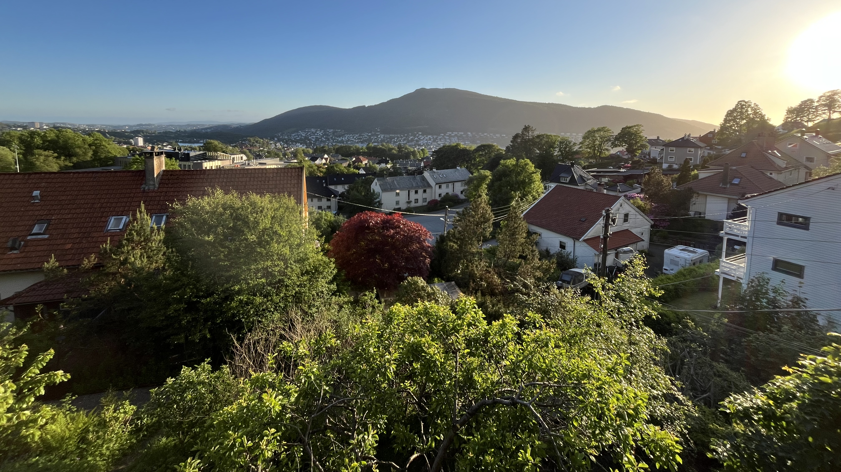
Chrono-city topics
Scott Bremer (University of Bergen and NORCE Research)

Slide 2
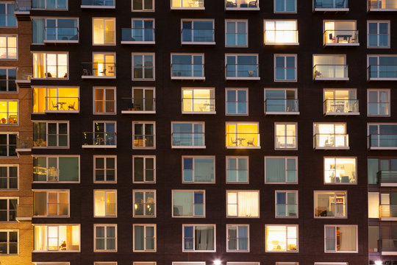

Slide 3
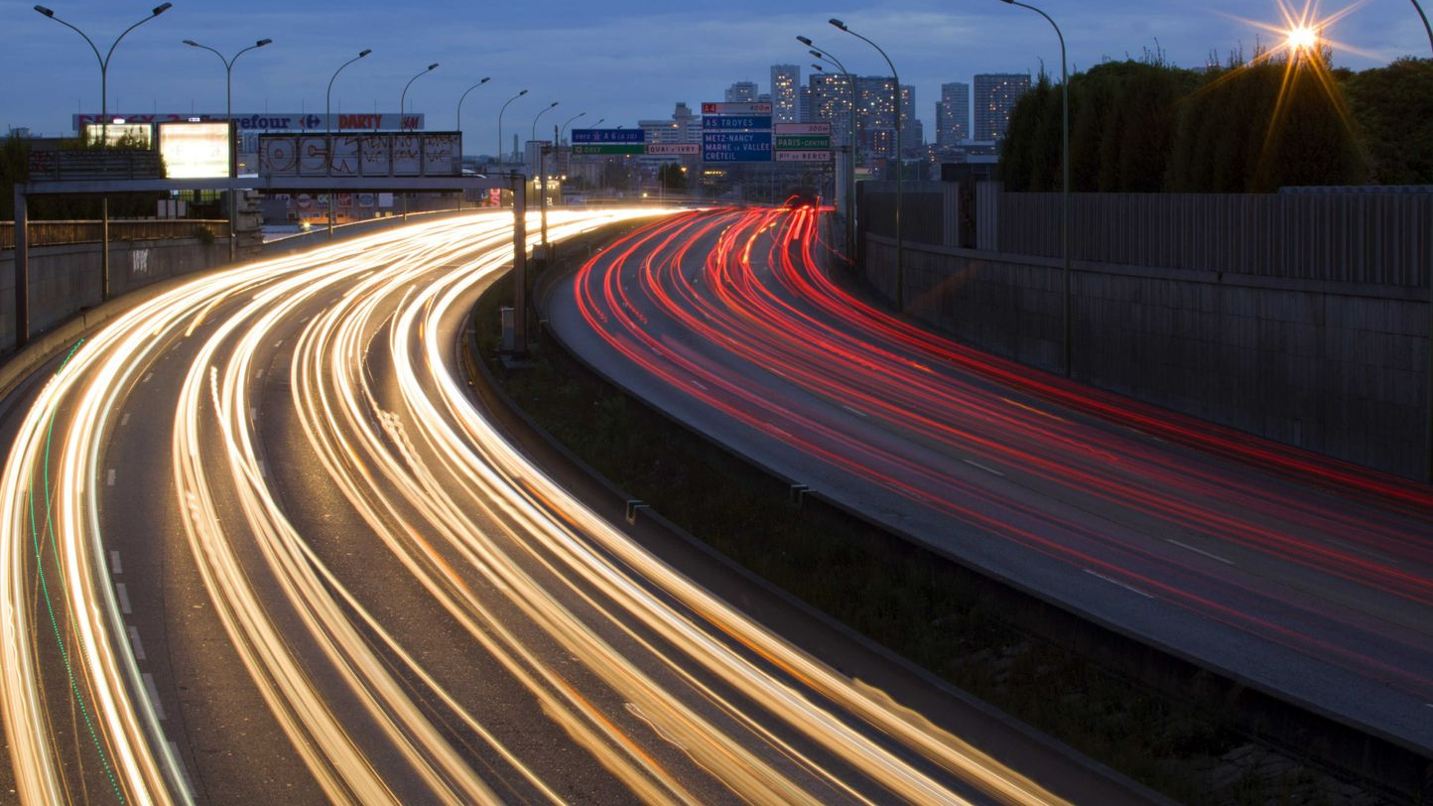

Slide 4
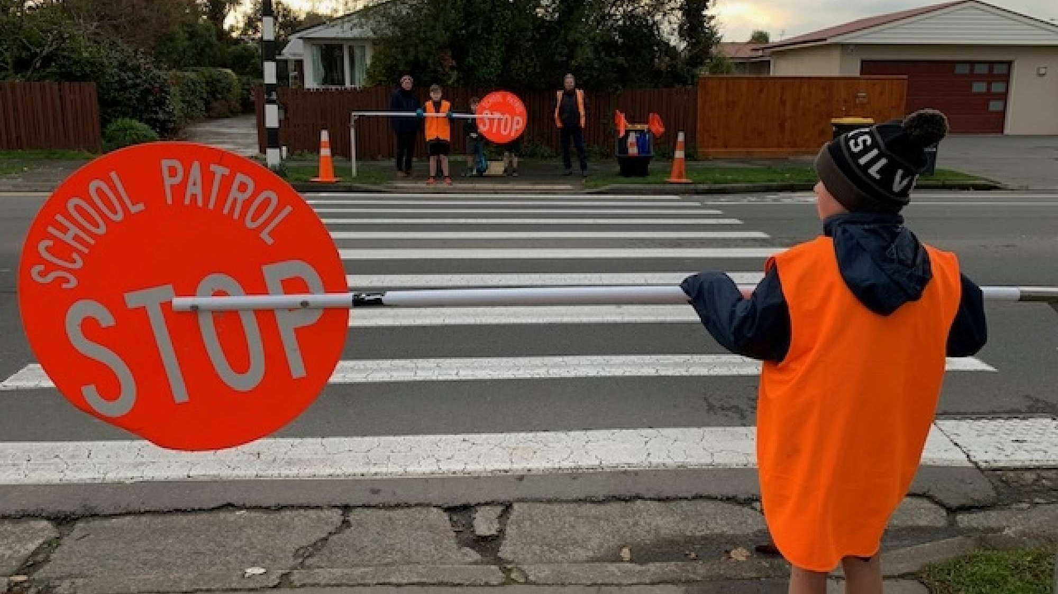

Slide 5
