Slide 1






THE CIRCADIAN CITY
Dr. Diego Golombek
Universidad de San Andrés / CONICET
@DiegoGolombek
@Diego.Golombek
TIME

Slide 2
We tend to imagine, design and live our cities in space
But our planet, and our bodies, live in time

Slide 3
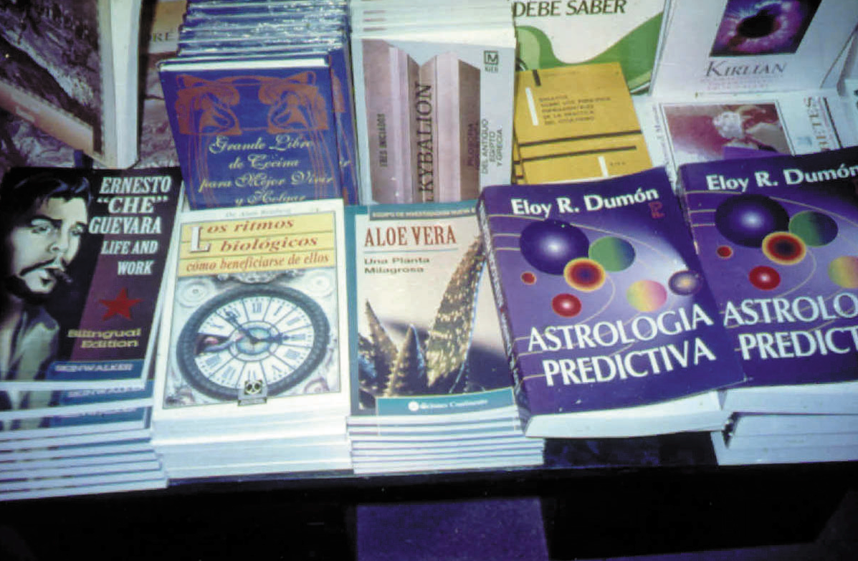
CHRONOBIOLOGY IN ARGENTINA

Slide 4
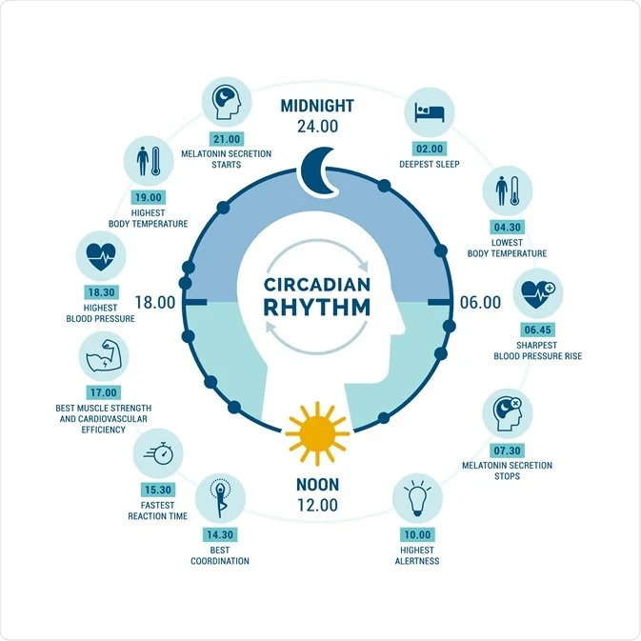
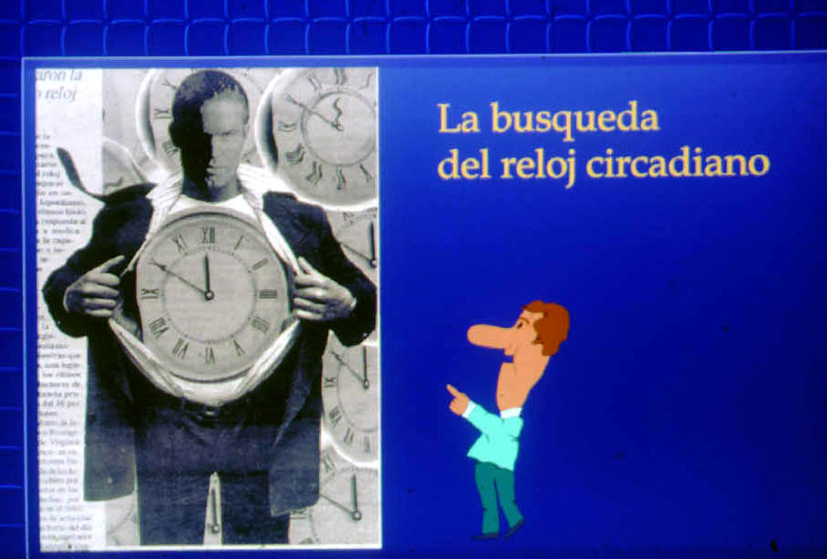
We all have a clock within us

Slide 5
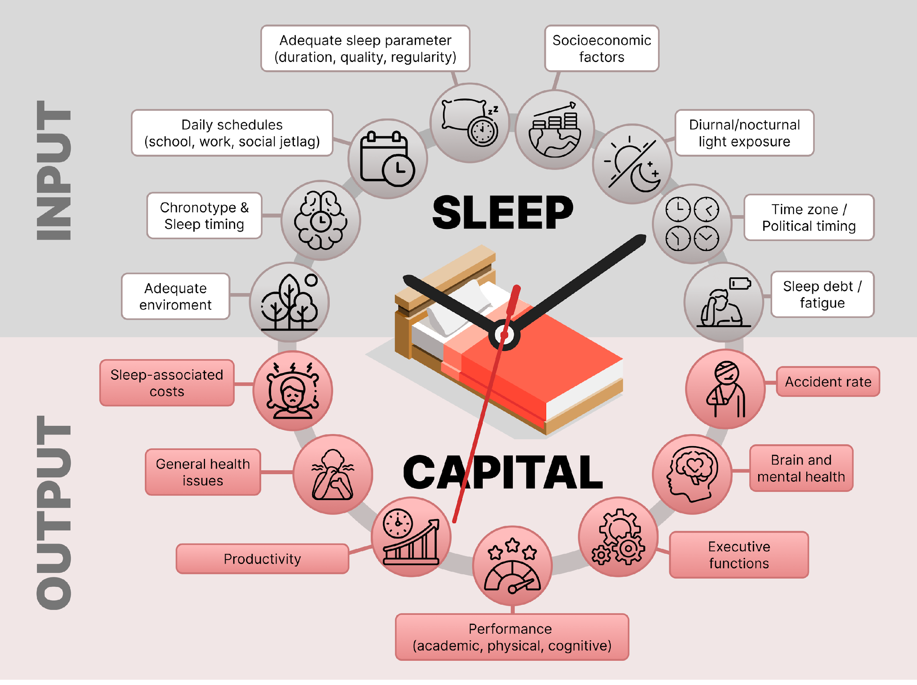
Golombek et al., 2024

Slide 6
SO WHAT
Somnolence
Mood
Metabolism
Memory and learning
Obesity
Diabetes
Inmune system
Accidents
Economic effects (1-3% GDP!)

Slide 7
The problem
DATA

Slide 8
The data
National Health Surveys
Mental Health Surveys (e.g., depression)
Sleep surveys
National Time Use Surveys

Slide 9
The data
National Health Surveys
Mental Health Surveys (e.g., depression)
Sleep surveys
National Time Use Surveys

Slide 10
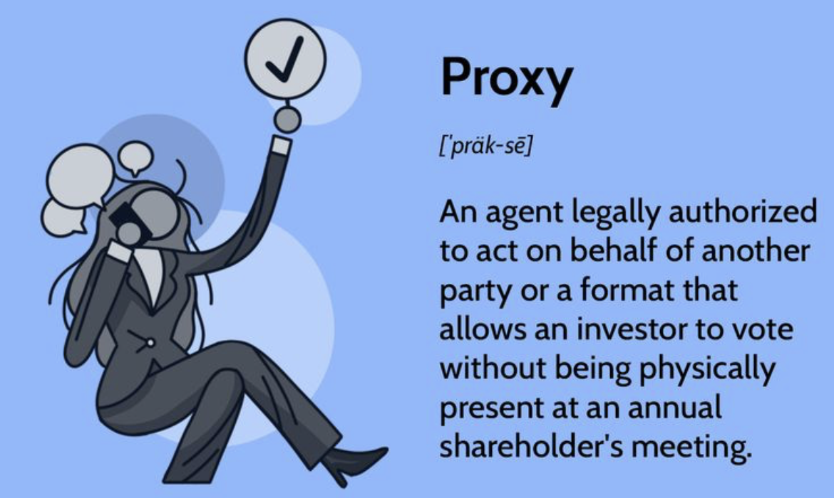
♥️ investopedia

Slide 11
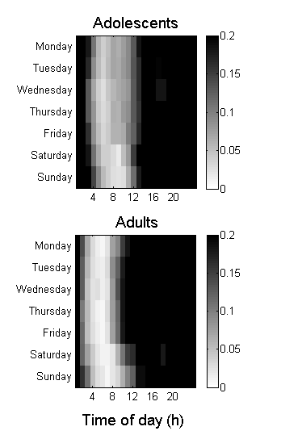
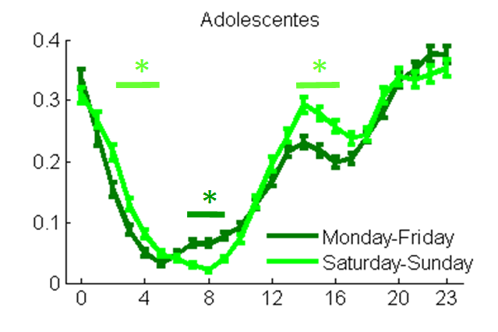
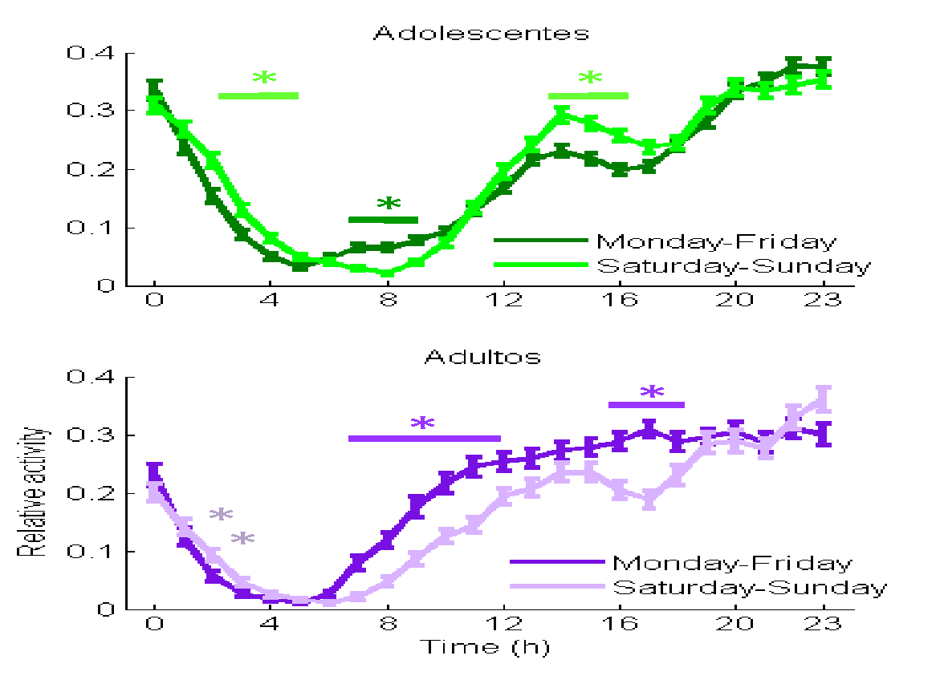
Twitter Activity
ADOLESCENTS
ADOLESCENTS
Normalized Activity
ADULTS
Day of week
ADULTS
Time of day (h)
Time of day (h)
2000 tweets by user, nadults=110, nadolescents=198
Spiousas, Carrillo et al.
Notes:
Just to show you some of the work we are starting with, we filtered Twitter users database to obtain Argentinean users under 18 and adults. We studied the diurnal variations in activity during the workdays and the weekend, finding evidences of social jet lag on both groups: both adolescents and adults start twitting earlier during the working days in comparison to the weekend. If we plot the data as an actogram using the activity mean on each day of the week versus time, we observe that adolescents have an advanced but small burst of activity during workdays, but normal levels are reached later, at the same time that during weekends. In adults, high levels of twitting are reached earlier during the workdays. Then, one of the challenges of using this type of data is the definition of a correct phase marker.

Slide 12
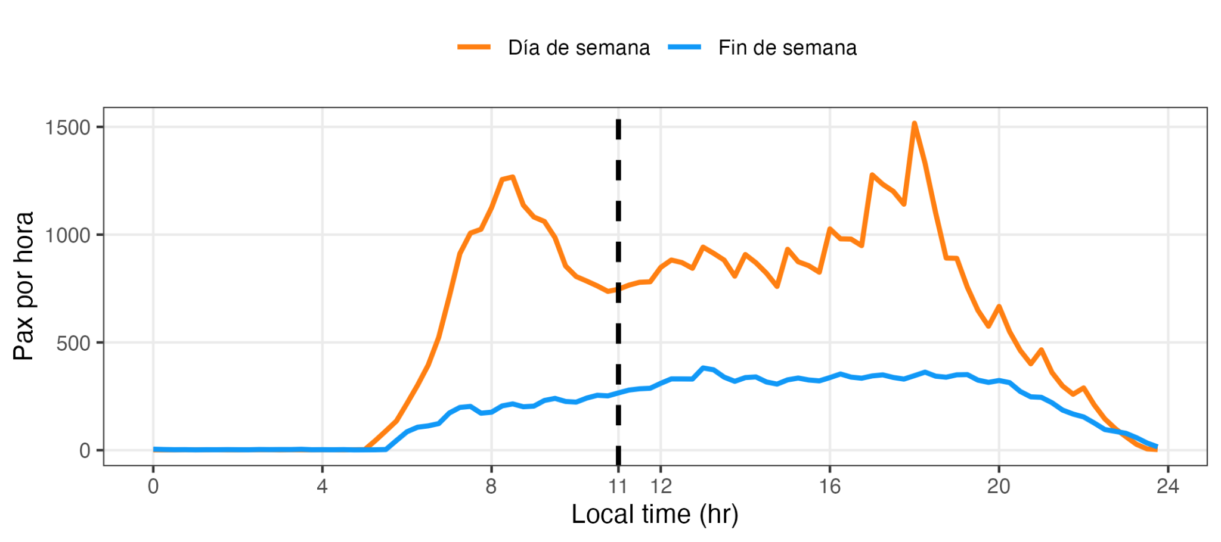
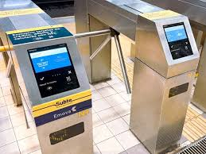

Transportation data
Ignacio Spiousas
Notes:
Los pasajes hasta las 11 am como un proxy de la presencialidad.

Slide 13
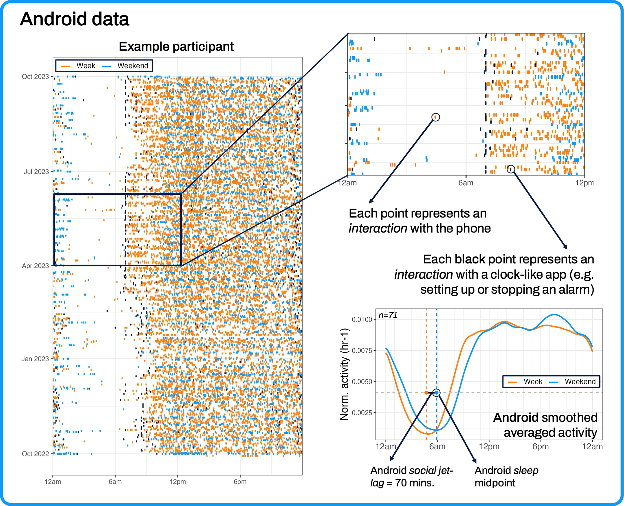
INDIVIDUAL PROXIES: CELLPHONE USE
Spiousas, Casiraghi, Morán

Slide 14
FROM INDIVIDUALS TO SOCIETIES

Slide 15
FIVE POLICIES FOR CHRONOCITIES
What time is it
Light at night (and day)
The circadian hospital
School timing
Working across the clock

Slide 16
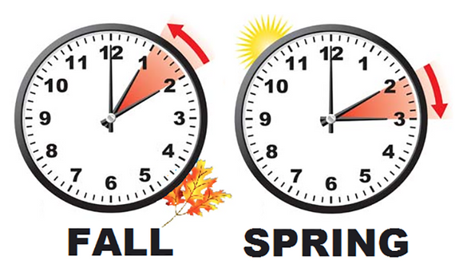
FIVE POLICIES FOR CHRONOCITIES
What time is it
Light at night (and day)
The circadian hospital
School timing
Working across the clock
What time is it:
- body?
- planet?
- city?
Time zones
Daylight saving time?

Slide 17
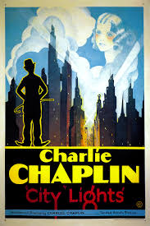
FIVE POLICIES FOR CHRONOCITIES
What time is it
Light at night (and day)
The circadian hospital
School timing
Working across the clock
Light at night (and day)
- Screen use
- City lights
- Light pollution for all
- Diurnal light

Slide 18

FIVE POLICIES FOR CHRONOCITIES
What time is it
Light at night (and day)
The circadian hospital
School timing
Working across the clock
Circadian hospitals
- Chronopharmacology
- Illumination
- ICUs and NICUs
- Diagnosis and treatment
- Medical shifts

Slide 19
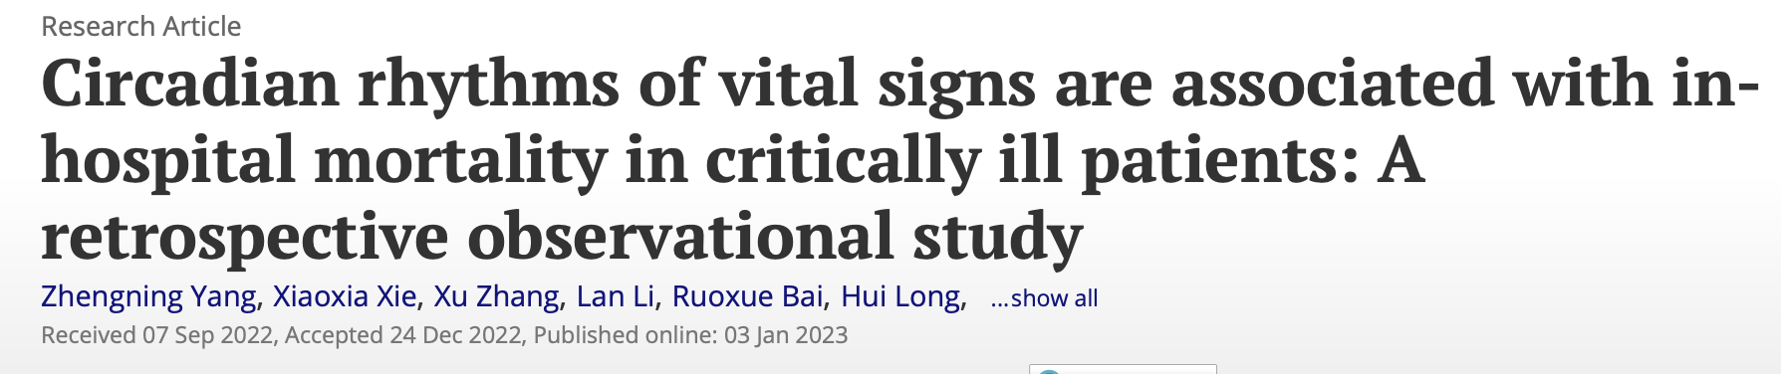
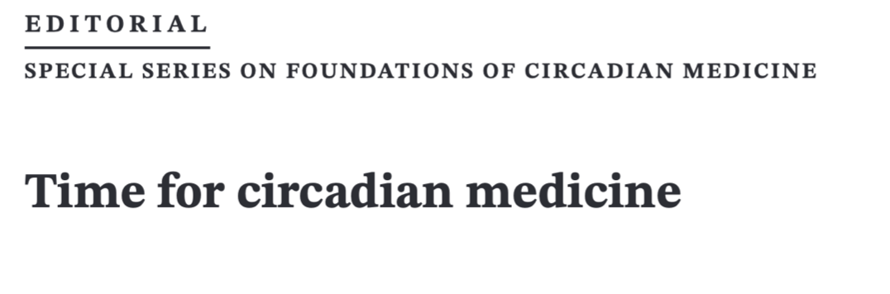
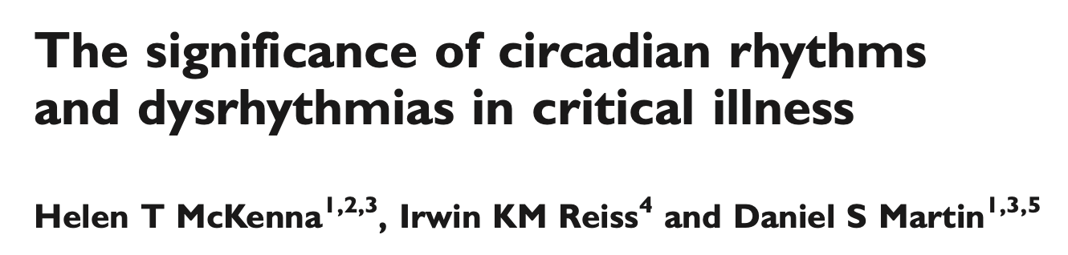
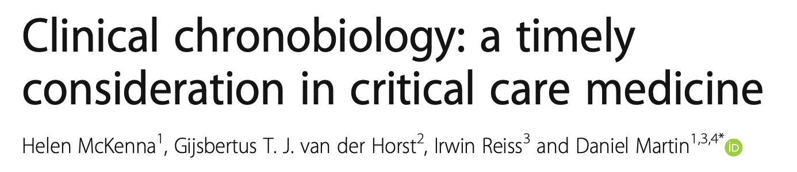
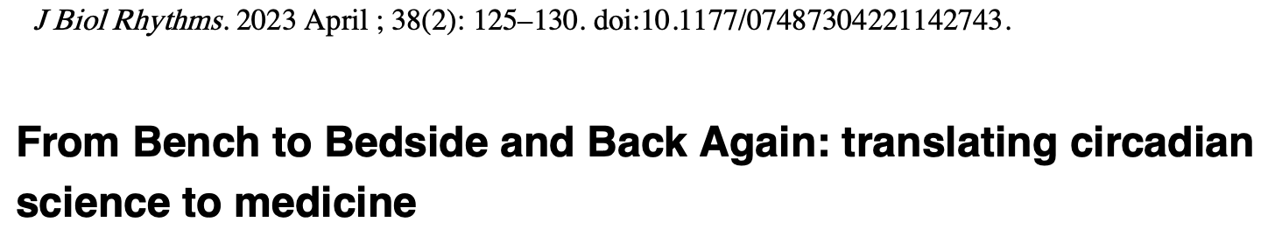
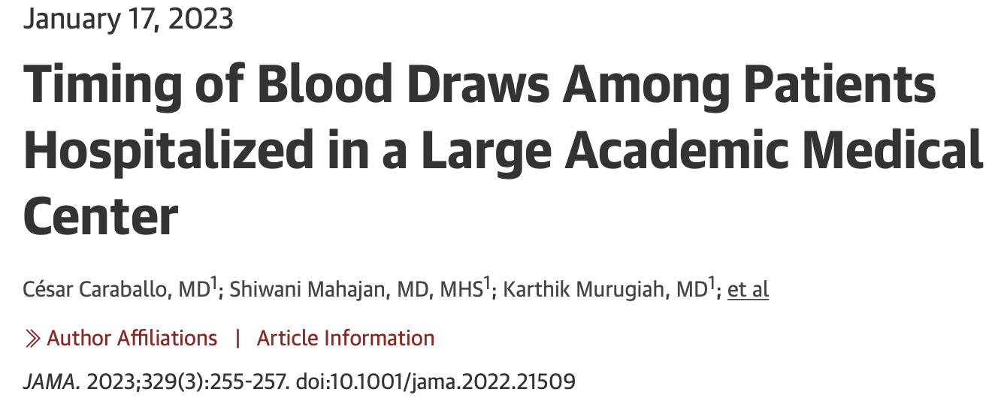
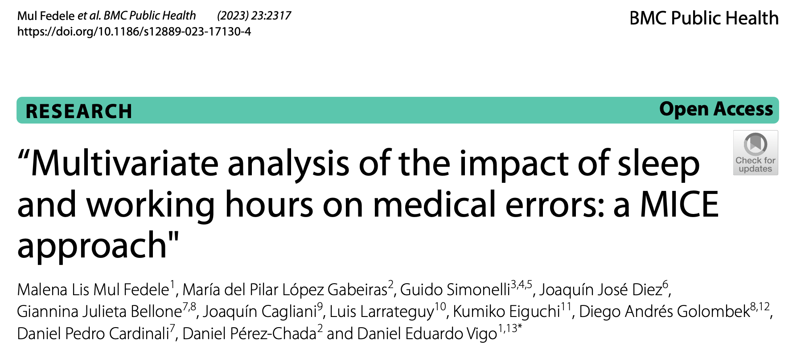
THE CIRCADIAN HOSPITAL

Slide 20
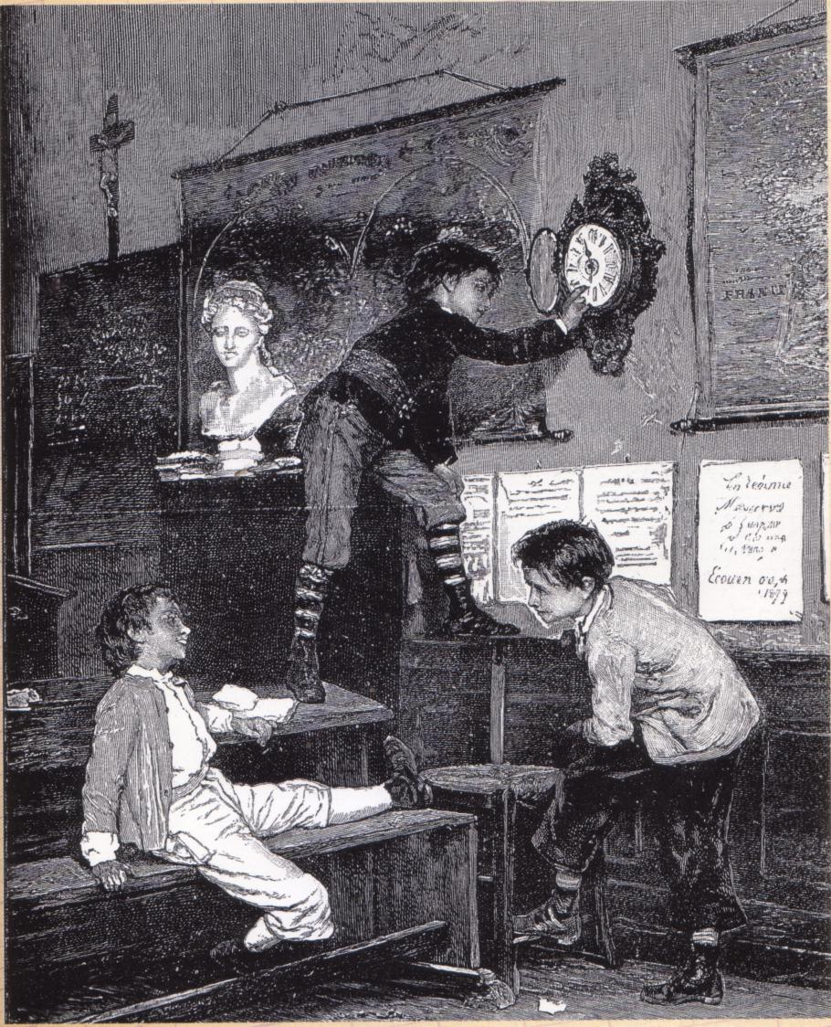
FIVE POLICIES FOR CHRONOCITIES
What time is it
Light at night (and day)
The circadian hospital
School timing
Working across the clock
School timing
- School start-times
- School schedules
- Illumination

Slide 21
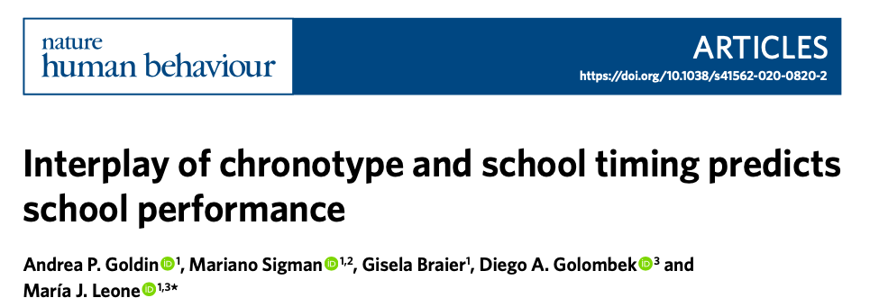

Slide 22

FIVE POLICIES FOR CHRONOCITIES
What time is it
Light at night (and day)
The circadian hospital
School timing
Working across the clock
Work timing
- Working time
- Shiftwork
- Fatigue
- Illumination

Slide 23
IN SUMMARY
Define/Measure sleep capital
Data, data, data
Exposed and hidden sleep costs
Sleep and public policies

Slide 24
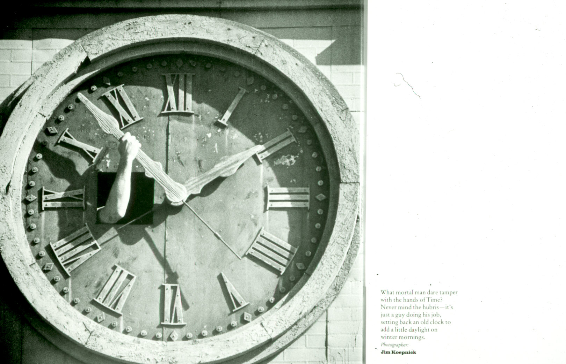
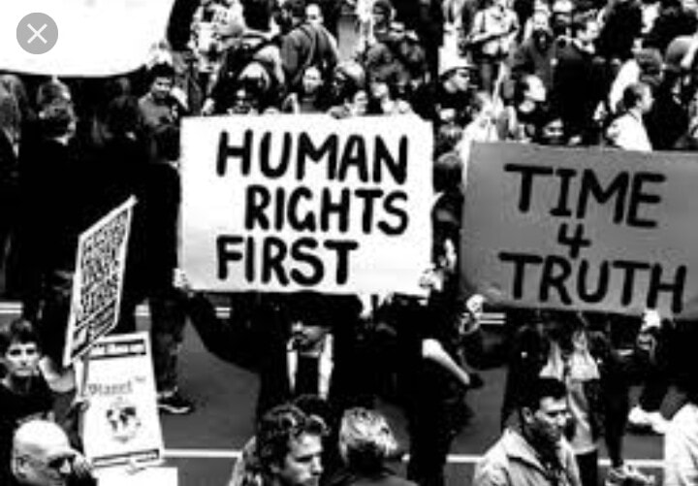
A RIGHT TO CHRONOCITIES

